Slide 1
Relational Database Management System (RDBMS)
240110102

Slide 2
Relational Vs. Non Relational DBMS
Relational | Non-Relational
Data stored in structured format | No fix structure
Store and retrieval of data is easy | Not easy to manipulate data
Can use SQL | No fix language, it depends on the data storage format
Data stored in form of rows and column (relation) | Data in form of document , column-oriented, key-value store and graph
Any application can use the database | These types are used for a single application.
Can define key for unique identification of record, integrity constraints can be impose | There are no tables, rows, primary keys or foreign keys
Most popular relational databases have been Microsoft SQL Server, Oracle Database, MySQL and IBM DB2. Several free versions of these RDBMS platforms have gained popularity over the years, such as SQL Server Express, PostgreSQL, SQLite, MySQL and MariaDB. | Popular NoSQL databases are MongoDB, Apache Cassandra, Redis, Couchbase and Apache HBase

Slide 3
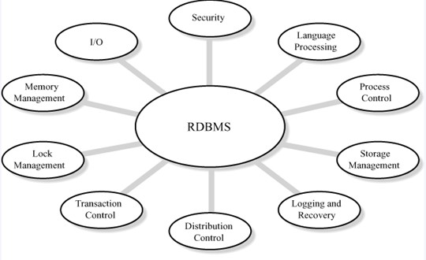
Benefits of using RDBMS

Slide 4
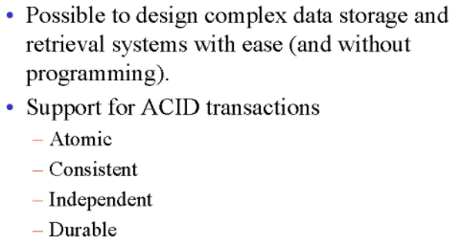
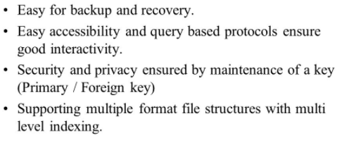
Benefits of using RDBMS

Slide 5
Types of Databases
Text/ file databases
A large portion of the information available worldwide in electronic form is actually in text form (other popular forms are structured and multimedia information).
Relational database
Microsoft SQL Server, Oracle Database, MySQL and IBM DB2.
NoSQL database
many different types of NoSQL databases, with different specifications: Key value, graph etc…
MongoDB is a most popular NoSQL Database (document-oriented database) that stores JSON-like documents in dynamic schemas
Cassandra DB is also highly scalable. Facebook® created Cassandra DB
The Firebase Realtime Database is a cloud-hosted NoSQL database
Cloud database
5 Best Cloud Databases to Use in 2021. Amazon DynamoDB, Google BigQuery, Azure SQL Server, Azure Cosmos DB, Amazon Redshift
Object-oriented database
An object-oriented database is based on object-oriented programming, so data and all of its attributes, are tied together as an object. Object-oriented databases are managed by object-oriented database management systems (OODBMS). These databases work well with object-oriented programming languages, such as C++ and Java
Examples: Wakanda, ObjectStore
Hierarchical database
Hierarchical databases use a parent-child model to store data. If you were to draw a picture of a hierarchical database, it would look like a family tree, with one object on top branching down to multiple objects beneath it.
Examples: IBM Information Management System (IMS), Windows Registry

Slide 6
Components of DBMS
1. Database Engine | The core service for accessing and processing data. It handles storage, query processing, and transaction management.
2. Data Definition Language (DDL) Compiler | Interprets and processes DDL statements like CREATE, ALTER, DROP to define schema and structure of the database.
3. Data Manipulation Language (DML) Compiler | Translates DML statements (INSERT, UPDATE, DELETE, SELECT) into low-level instructions the DBMS engine can execute.
4. Query Processor | Analyzes, parses, and optimizes SQL queries before execution. Converts high-level queries into efficient execution plans.
5. Transaction Manager | Ensures ACID properties (Atomicity, Consistency, Isolation, Durability) during transactions. Manages concurrency and crash recovery.
6. Storage Manager | Manages storage space on disk and memory. It handles data files, indexes, and data buffering for optimized access.
7. Buffer Manager | Controls data transfer between disk and main memory (RAM). Keeps frequently used data in memory for faster access.
8. Authorization and Integrity Manager | Enforces user access controls and data validation rules. Ensures only authorized users can access or modify the data.
9. Catalog/Metadata Manager | Maintains metadata — data about database structure like tables, columns, data types, indexes, constraints, etc.
10. User Interface or Query Interface | Allows users to interact with the DBMS. Interfaces may include command-line (e.g., SQL prompt) or graphical tools (e.g., MySQL Workbench).

Slide 7
DBMS Languages
In a Database Management System (DBMS), special languages are used to perform tasks such as defining the structure of data, manipulating data, and controlling user access. These are called DBMS languages and can be categorized into:
DDL – Data Definition Language
DML – Data Manipulation Language
DCL – Data Control Language

Slide 8
DDL – Data Definition Language
DDL is used to define the structure of database objects such as tables, schemas, indexes, and views.
DDL statements do not manipulate data.
They only define or change the structure of database objects.
Common DDL Commands:
Create
Alter
Drop
Truncate

Slide 9
DML – Data Manipulation Language
DML is used to manipulate and manage data in the database.
These commands allow inserting, updating, deleting, and retrieving data.
Common DML Commands:
Select
Insert
Update
Delete

Slide 10
DCL – Data Control Language
DCL is used to control access to data and database objects. It manages user privileges and permissions.
Common DCL Commands:
Grant
Revoke

Slide 11
Traditional RDBMS
Based on Relational Model (tables, rows, columns).
Use Structured Query Language (SQL).
Great for structured data
Strong ACID (Atomicity, Consistency, Isolation, and Durability) compliance.
Examples: Oracle, MySQL, SQL Server, PostgreSQL

Slide 12
NoSQL
NoSQL = “Not only SQL” – a broad class of non-relational databases designed for:
High scalability
Flexible schema-less structure
Unstructured/semi-structured data
🔍 Key Characteristics:
Horizontal scalability (easier distributed architecture)
Schema flexibility (can change structure anytime)
High performance for specific workloads
For better performance and availability use BASE: Basically Available, Soft state, Eventually consistent (NOT ACID)

Slide 13
Types of NoSQL Databases:
Type | Description | Example
Document-based | Store data in JSON-like documents | MongoDB, CouchDB
Key-Value Stores | Simple key-value pairs | Redis, DynamoDB
Column-based | Store data in columns for fast retrieval | Cassandra, HBase
Graph-based | Store data as nodes and relationships | Neo4j, ArangoDB

Slide 14
When is NoSQL Used?
Real-time analytics
IoT applications
Social media platforms
Content management systems
Applications with massive amounts of unstructured data

Slide 15
NewSQL
NewSQL refers to modern relational databases
Use SQL as query language
Provide ACID compliance
Offer scalability like NoSQL
NewSQL = Best of both worlds: SQL + Scalability
Why NewSQL?
To address scalability limitations of traditional RDBMS without giving up SQL features or transaction integrity.
Designed for cloud-native applications.

Slide 16
Key Features of NewSQL:
Distributed architecture for high availability
Full SQL support (joins, indexes, ACID)
In-memory capabilities for speed
Auto-sharding (sharding refers to the practice of horizontally partitioning a large database into smaller, more manageable pieces called shards, which are distributed across multiple servers) and replication (process of creating and maintaining multiple copies of data across different nodes or servers)

Slide 17
Popular NewSQL Databases
Database | Features
Google Spanner | Global distribution, strong consistency
CockroachDB | Fault-tolerant, scalable SQL
VoltDB | In-memory processing for speed
NuoDB | Cloud-native, elastic scaling
TiDB | MySQL compatible, supports hybrid workloads

Slide 18
Comparison: RDBMS vs NoSQL vs NewSQL
Feature | RDBMS | NoSQL | NewSQL
Data Model | Relational | Non-relational | Relational
Query Language | SQL | Varies | SQL
Scalability | Vertical | Horizontal | Horizontal
ACID | Yes | No (BASE) | Yes
Schema | Fixed | Flexible | Flexible
Best Use | Structured data | Big data, IoT, social apps | Cloud apps needing SQL + scale
NoSQL = flexible, fast, scalable → good for modern apps with unstructured data.
NewSQL = power of SQL with scalability → best for enterprises needing reliability + scale.

